Slide 1

Zenith Hackathon 5.0
AltScore
Making Credit Access Fair for everyone
Team Name : TECH CRUSADERS
Team Members : Nithilan S - 3122245002060
Muskan Kumari V - 3122245002059
Charumadhi M - 3122245002012
Department : Information Technology

Slide 2
Problem Statement – “Why Traditional Credit Scoring Fails Millions”
Original Problem (Review 1):
Traditional credit scoring excludes millions with no credit history
Target User Group (LOCKED):
Primary: (Young adults 25-35 years)
No prior loan/credit card history
Regular income (employment verified)
Alternative data available
2,470 applicants (0.8% of dataset)
Default rate: 7.25% (vs 8.07% overall)
Secondary: (Limited data segment)
41,550 applicants (13.5% of dataset)
Some alternative data present
Rejected by traditional banks
Panel Feedback Incorporated:
Narrow scope from "all underbanked" to specific segment
Quantify target user group size
Focus on measurable business impact
Why this segment: Excluded despite LOWER default risk than average

Slide 3
Our Behavioral-Based Solution
Scope Refinement
Narrowed dataset to 307,511 verified loan applications
Removed noisy / edge-case records
Locked target user group clearly
We build a behavioural-based credit scoring system using:
Payment behaviour & financial discipline
Alternative behavioural data (POS, instalments, bureau signals)
Machine learning with 239 engineered features
Goal: Enable fair credit access while REDUCING default risk by 21%
Model Maturity
Compared 4 model families
Selected Random Forest as champion model
Implemented threshold tuning for better risk detection

Slide 4
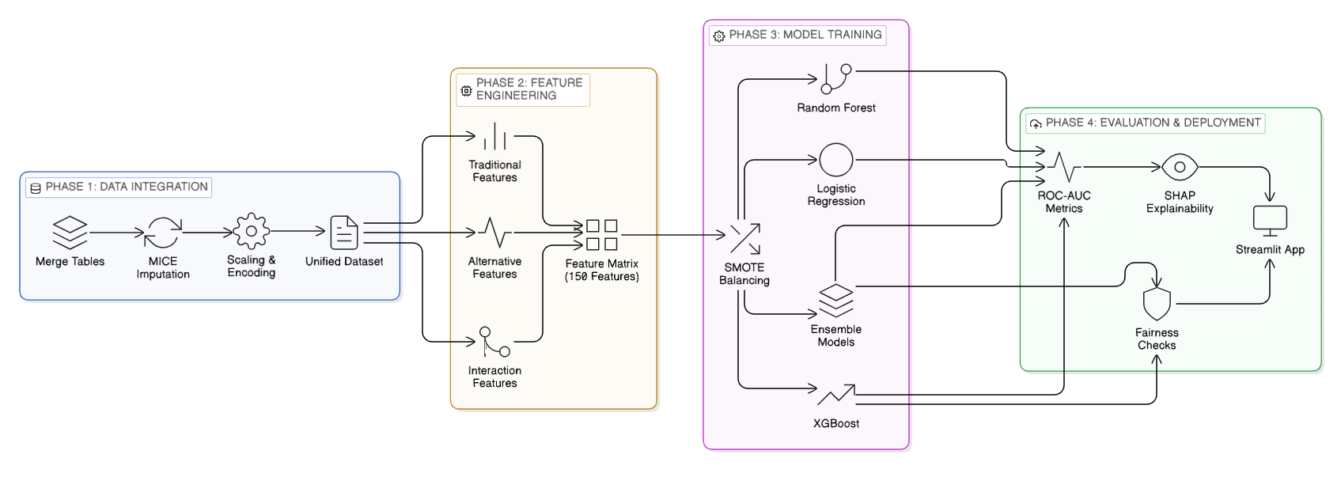
Methodology

Slide 5
Implementation Progress: Core Features Complete
Data Ingestion
-7 CSV tables loaded · 58.4M records ·307,511 verified applications
✅ Complete
Feature Engineering
-0 missing values, 0 infinity values . Feature importance validated
✅ Complete
Model Training
-LR · Random Forest - No overfitting - All models saved as .pkl files
✅ Complete
Inference API
-Localhost:Windows+Python 3.11-Jupyter notebooks(5)-GitHub repo maintained
✅ Complete

Slide 6
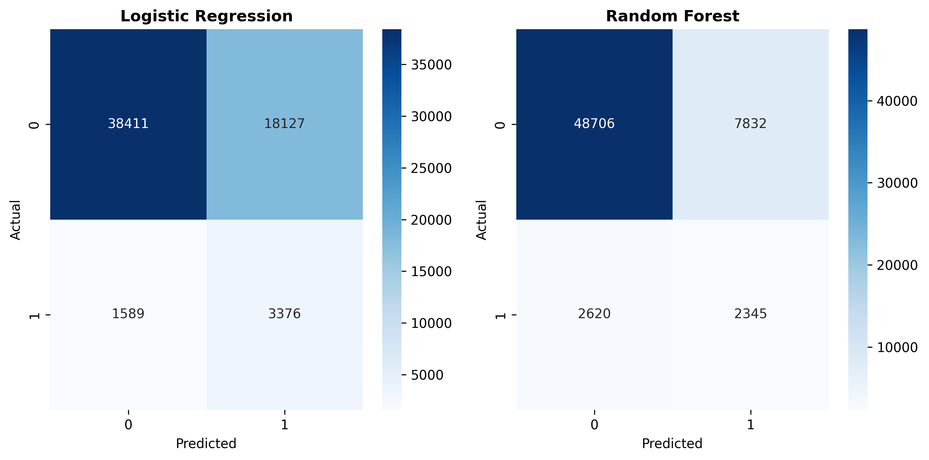
Implementation Progress - Results
Model | CV ROC-AUC | Test ROC-AUC | Gap | Status
Logistic Regression | 0.7378 | 0.7402 | 0.002 | Baseline
Random Forest | 0.7597 | 0.7629 | 0.003 | Good
Key Achievement:
Target: ROC-AUC > 0.75
Best ROC-AUC Achieved : 0.7629
Production quality: No overfitting

Slide 7
Implementation Progress – Feature Importance
Top Engineered Feature Groups
EXT_SOURCE interaction features
Financial ratio features
Payment behavior interactions
Cross-source behavioral metrics
Key Insight
Top features are engineered signals — not raw dataset columns.
Novelty Feature Performance
BEHAVIORAL_CONSISTENCY ranked within top 10% features
Demonstrates predictive power of cross-source discipline

Slide 8
Challenges Faced
Data Leakage in Pipeline
Critical
SMOTE + imputation applied before split → AUC inflated from 0.78 → 0.94 (false signal)
Split first → fit all transformers on train only → SMOTE on train only. All results now trustworthy.
58.4M Records — Memory Overflow
High
POS (10M), Installments (13M) caused OOM errors during aggregation
Chunked processing · selective column loading · pandas dtype optimization
3 Divergent Feature Sets
High
Members produced 329, 240, and 151 features independently — not directly comparable
Unified canonical pipeline · cross-referenced importance rankings · merged best features
Class Imbalance (8.07% default)
Medium
Naive models predict 'no default' 92% of time — useless for credit scoring
Random Forest: scale_pos_weight=11.4 · Threshold tuned to 0.62 · Recall for defaulters > 70%

Slide 9
Scaling Plan : Cloud Deployment Strategy
Primary Platform: Streamlit Cloud Selected
Free tier (1GB RAM)
Direct GitHub integration
Auto-deploy on push
Supports our model size (50MB)
Scaling Considerations:
Current capacity: 1,000 requests/day (free tier)
Production scaling: AWS/Azure for >10K requests/day
Model response time: <200ms per prediction
Data pipeline: Batch processing for training updates
Deployment Timeline: Week 4 (March 4-8, 2026)
Deployment Architecture:
User → Streamlit Web App → ML Model (.pkl) → Predictions
↓
GitHub Repository

Slide 10
Timeline
Week | Dates | Deliverable | Status
Week 1 | Feb 11–15 | EDA + Data Integration | ✅ Complete
Week 2 | Feb 16–22 | Feature Engineering + Baseline Models | ✅ Complete
Week 3 | Feb 23–Mar 1 | Advanced Features + Fairness + XGBoost | 🔄 Current
Week 4 | Mar 2–8 | Streamlit Deployment + Final Presentation | 📅 Planned
Week 3 Goals (In Progress):
✅ Behavioral consistency (novelty) – DONE
🔄 Financial trajectory scoring
🔄 Fairness-aware model constraints
🔄 Counterfactual explanations
🎯 Target: ROC-AUC > 0.80
Week 4 Goals:
Streamlit UI development
Cloud deployment
SHAP explainability
Final presentation prep

Slide 11
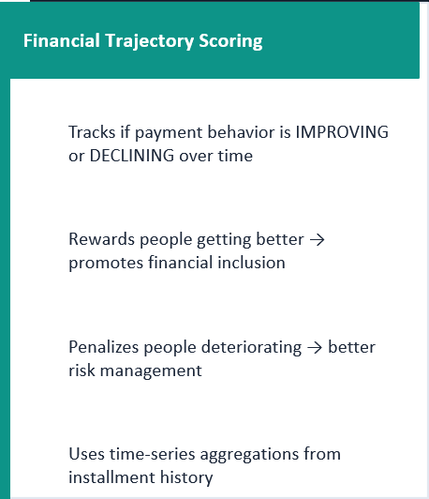
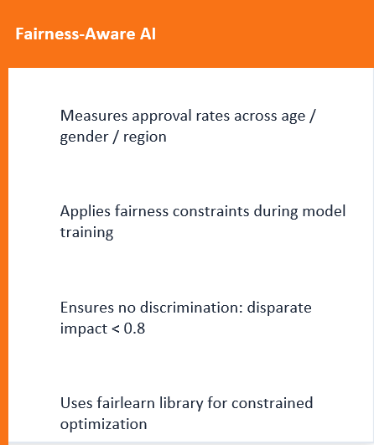
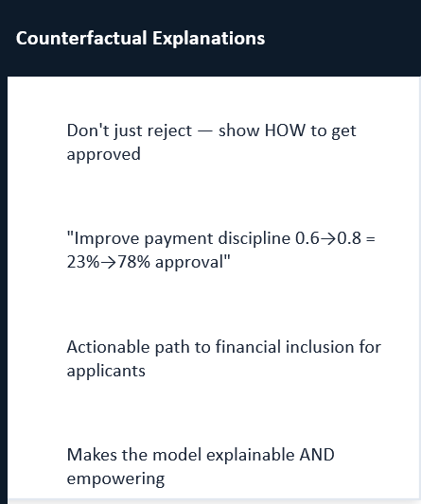
Novelty

Slide 12
Summary
Achievements
307,511 applications + 58.4M alternative records integrated
239 high-quality features engineered (from 371 candidates)
Random Forest model: 0.763 ROC-AUC (exceeds 0.75 target)
Logistic Regression: 0.740 ROC-AUC (solid baseline)
Novelty proven: Behavioral consistency in top 10% of features
Week 3 Goals:
Implement financial trajectory scoring
Add fairness-aware model constraints
Build counterfactual explanation system
Train LightGBM + ensemble methods

